Slide 1

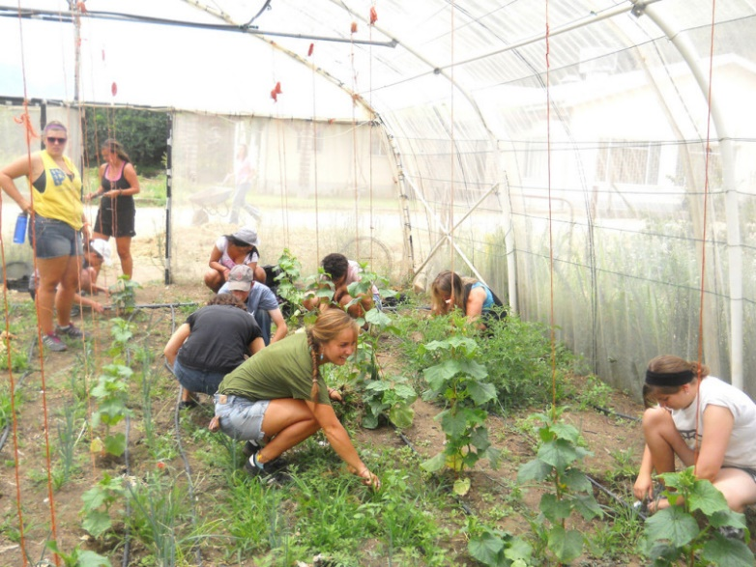
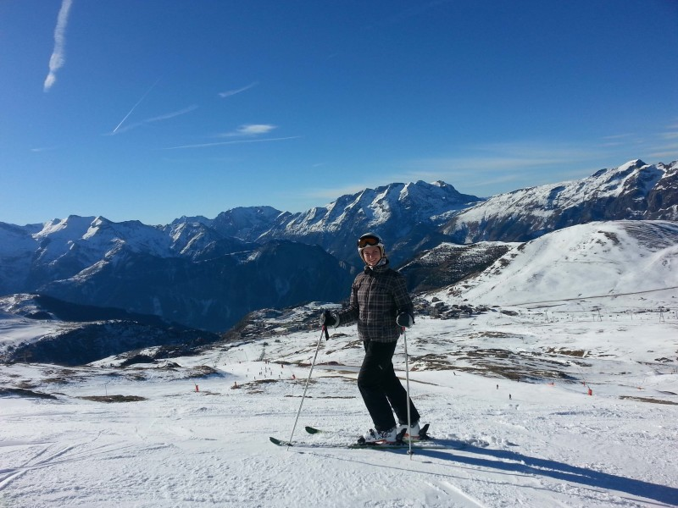

INFO SESSION TITLE
Clark Study Abroad & Away | Corner House | 142 Woodland St
studyabroad@clarku.edu | clarku.edu/studyabroad
Notes:
Study Abroad 101 Script
Kuy: Good afternoon everyone and welcome to our Study Abroad 101 Information session! The goal of this session is to introduce to all of you what study abroad and away are, what exactly those words encompass at Clark, how it might fit into your plans and Clark, and lastly, how you could go about starting the process if you’re interested.
(Introduction Slide)
My name is Kuy Howard, I am the newly appointed Study Abroad Advisor and Program Coordinator here at Clark. Joining me today is our Director of Study Abroad & Away, Alissa Briggs and our Undergraduate Program Coordinator, Alex.
Together we hope to walk you through what Study Abroad and Away at Clark has to offer, how you can participate, and answer any questions you might have along the way.

Slide 2

about
Important Dates:
Application Open
Application deadline
Program dates:

Slide 3
Academics
Course info/description
Credits
PLS?

Slide 4
EXCURSIONS

Slide 5
HOUSING

Slide 6
INCLUSIONS
Private bus transfer from Rome to Perugia on arrival
Course credit and course materials
Excursions
Housing
Pre-departure and on-site student support
GeoBlue health insurance
On-site orientation

Slide 7

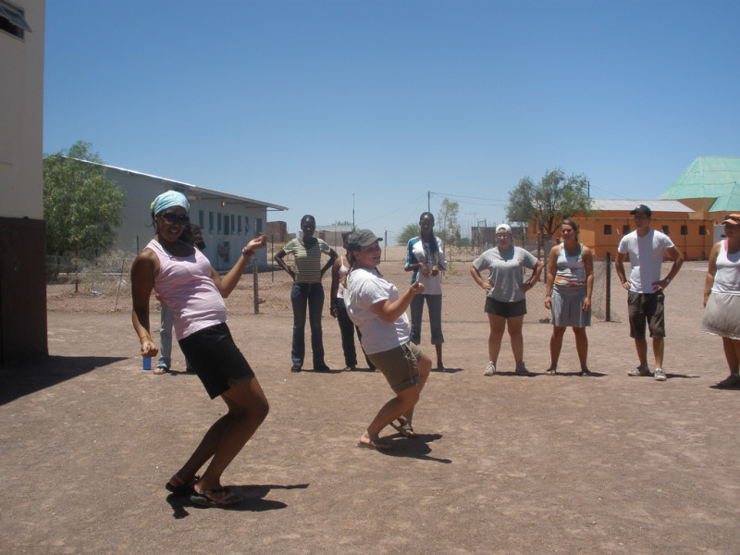
Requirements
Students should be in good standing with the University when (academic, social, financial).
Recommended GPA 2.75 (if you have a lower GPA, talk to us!)
Students from any major / or undecided
All class levels (preference given to undergraduate students whose course credit and/or PLS will go towards graduation requirements)
NO language experience needed
NO prerequisites for these classes; they are intended for students from all majors!
Once admitted, students will be expected to:
Attend a pre-departure orientation
Attend on-site orientation

Slide 8

Billing & Budgeting
Students pay full program fee to Clark, includes:
Tuition
Housing
Excursions
On-site student support
Health insurance?
Students responsible for:
Cost of flights or independent travel
Meals
Personal expenses
International students may need to purchase a visa
PROGRAM COST: TBC

Slide 9
Scholarship support
Career Connections: Funding for Opportunities | Career Connections Center (clarku.edu)
External scholarships
FEA Scholarships – Fund for Education Abroad
International Student Scholarship Search & International Financial Aid (iefa.org)
Study Abroad | First Trip
Start the research process early!
Review & edit your applications; Get help from the writing center, family, friends and mentors!

Slide 10
APPLICATION details
Students will create an online application at studyabroad.clarku.edu
Once you create an application, you will see all the materials that will be required, including:
Short answer questions
A recommendation
Application deadline?

Slide 11
Timeline & Next Steps
Research programs
Discuss your plans with your family and advisors
Know of someone that can write you a reference
Connect with the Study Abroad Office
Visit Drop-in Hours; Follow our social media accounts, check clarku.edu/offices/studyabroad for info.
Send us an email: studyabroad@clarku.edu
Talk with a Study Abroad Global Ambassador
Apply by stated deadlines!
VIEW ALL PROGRAMS AND OPEN AN APPLICATION HERE:
studyabroad.clarku.edu

Slide 12
Interest form
QR Code placeholder

Slide 13




Thank you!!
Drop-in Hours
Mon, Wed, Fri: 12-2pm
Website & Email
clarku.edu/studyabroad
studyabroad@clarku.edu
Facebook
facebook.com/clarkstudyabroad
Instagram
@clarkiesabroad

